Slide 1

Building AI Powered Solution for Assisting Visually Impaired Individuals
(FriendlyFinder)

Slide 2


About me
I am currently in Final year of my Bachelors in Electronics and communication Engineering in Sri Venkateswara University College of Engineering, Tirupati.
Beyond technical skills, I am motivated by the opportunity to work where data science can be applied to various fields such as healthcare, business, technology, and social good.
I am currently an intern in Innomatics Research Labs, where I have been working on various data driven projects. Additionally I have done some courses related to Data Science and Artificial intelligence .
https://www.linkedin.com/in/gopisetty-sai-charan-gsc12104016/
https://github.com/Sai34Charan

Slide 3
Introduction
FriendlyFinder is an AI-based application designed to assist visually impaired individuals.
Key features:
Description of the Scene
Text Extraction using OCR
Text-to-Speech Conversion

Slide 4
Key Features
🔍 Describe Scene: Provides a detailed description of the uploaded image.
📝 Extract Text: Extracts text from images using Optical Character Recognition (OCR).
🔊 Text-to-Speech: Converts extracted text to speech for auditory consumption.

Slide 5

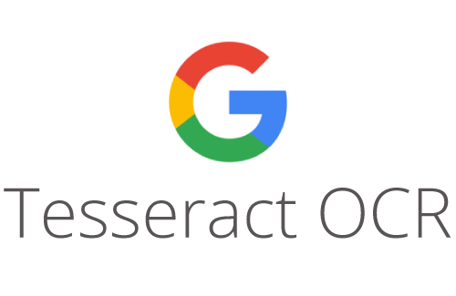

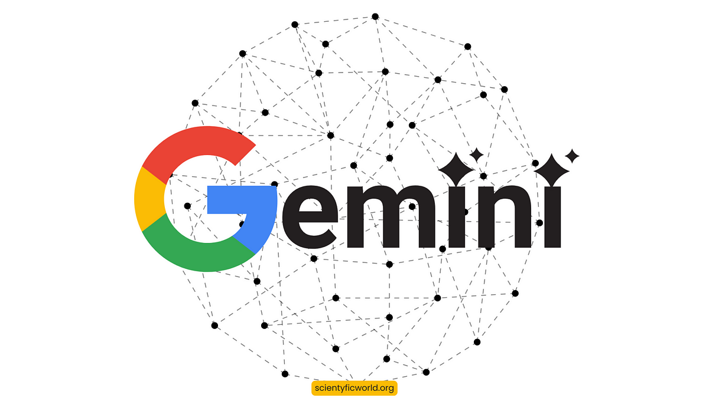
Technologies Used
Tesseract OCR: For text extraction from images.
Google Gemini API: For generating scene descriptions.
pyttsx3: For converting text to speech.
Streamlit: For building the web interface.
Visual Studio Code : To write the code.

Slide 6

Upload Image Section
Uploading image data is the first step in initiating analysis, training models, or conducting image recognition tasks within the application.
Click on the ‘Upload’ button to begin. The images will be processed and prepared for the next phase of the application, such as analysis, training, or visualization.
Once uploaded, the images will be stored securely and can be accessed for further processing.

Slide 7
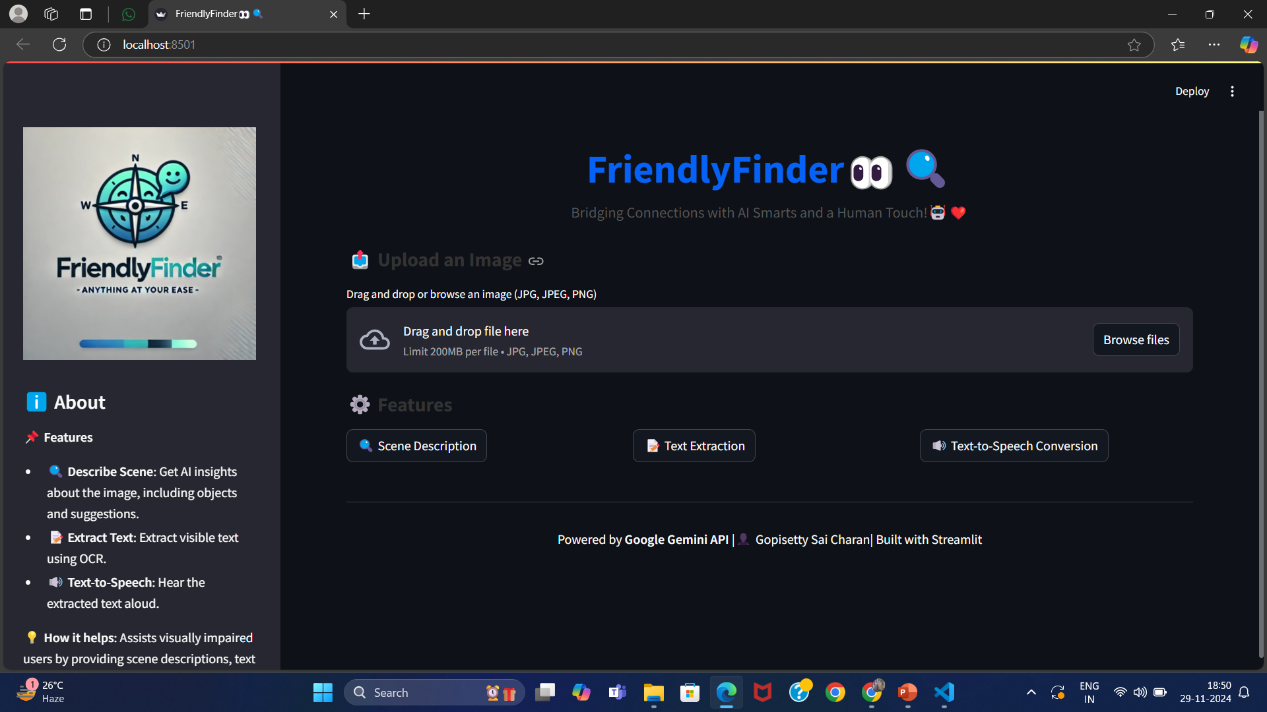
Website Overview

Slide 8
Text Extraction Feature
Uses Tesseract OCR to extract text from the image.
Extracted text is displayed and can be downloaded as a .txt file.
Text-to-Speech Feature
Extracted text is converted into speech using pyttsx3.
The audio is played back to the user and can be downloaded as an .mp3 file.

Slide 9
Conclusion
FriendlyFinder helps visually impaired individuals interact with the world using AI-driven technologies.
Future enhancements can include multi-language support, faster processing, and deeper integrations with accessibility tools.
Allows a downloadable option in each task.

Slide 10

THANK YOU

